Slide 1
Population genomics
RNA-seq
Eyal Privman
Department of Ecology and Evolution, University of Lausanne
PhD Summer School
June 2012

Slide 2
SNP discovery and genotyping from RNA-seq
Each sample may contain one allele (haploid), two (diploid) or more, as in our case of pooled samples:
5 males = 5 alleles
4 queens = 8 alleles
200 workers = 400 alleles
It’s more useful to sequence individual separately
It’s useful to detect SNPs using cohorts of sequenced individuals

Slide 3
SAMtools
Process SAM (Sequence Alignment/Map) and BAM format (compressed binary version of SAM)
E.g. Process Bowtie or TopHat alignments of RNA-seq or RAD-seq to a reference genome
Use the manual page to write samtools command lines: http://samtools.sourceforge.net/samtools.shtml

Slide 4
Convert BAM to SAM
Use samtools view to convert the binary format to readable text:
$ samtools view W422.accepted_hits.sort.bam | head
R2D2_0117:2:44:1714:17921#0 16 SIgn00001 79 50 75M * 0 0 ATTAAGTTCTAGTTCAAATAACTTAGGATTGTCTGTTGTATAGCTCACAAGCATGACGTAACCATTTGGTCCACG HHHHHFGGFGEDHHHHFHFHHBHDHHHHHHHHHHGGGGGD3HHHHHFHHHGGG>GGHHHGGHHHHGHHHHEHHHH XA:i:0 MD:Z:75 NM:i:0 NH:i:1
R2D2_0117:2:2:9366:2587#0 16 SIgn00001 96 50 75M * 0 0 ATAACTTAGGATTGTCTGTTGTATAGCTCACAAGCATGACGTAACCATTTGGTCCACGAACTTCCTGTATACCTG IIIGIIIIIIIHIIHIIIIIIIIIIIIIIHIHIIHIIIFIIIIIIIIIIIIIIIIIIIIIIIIIIIIIIIHHIII XA:i:0 MD:Z:75 NM:i:0 NH:i:1
R2D2_0117:2:26:7962:5823#0 16 SIgn00001 101 50 75M * 0 0 TTAGGATTGTCTGTTGTATAGCTCACAAGCATGACGTAACCATTTGGTCCACGAACTTCCTGTATACCTGTCTTA IIIIIIIIHHDGDDBIGGIIIIHIHIIIIIIIIHIIIIFIIIIIIIIIIIGIIIIIIIIIIIIIIIIIIIIHIII XA:i:0 MD:Z:75 NM:i:0 NH:i:1
R2D2_0117:2:75:3630:14196#0 0 SIgn00001 113 50 75M * 0 0 GTTGTATAGCTCACAAGCATGACGTAACCATTTGGTCCACGAACTTCCTGTATACCTGTCTTAGTCTTGTTCTTA HIIHIIIIHIIIIIIIIIIIIIHIFIIIIHHIIIHIIHFIIEGIIIIIIIIIHIHIHIHHIIIIIIIIIIIIHIG XA:i:0 MD:Z:75 NM:i:0 NH:i:1
...
...

Slide 5
Convert BAM to SAM
samtools view can cut a desired region for us:
(Note: BAM file needs to be sorted)
$ samtools view W422.accepted_hits.sort.bam SIgn00002:100,000-110,000
R2D2_0117:2:68:6557:15142#0 0 SIgn00002 108809 50 75M * 0 0 CTTAGAACTCATCATGTCTCACAATATACGCATCGCAAAACAGAAATTATCATCTATGGATCGAGGGTAAGCGTC IIIIIIIIIIIIIIIIIIIIIIIIIIIIIIIIIIIIIIIIIIIIIIIIHIIIIIIIIIIIIIIIIIIDHIIIIGI XA:i:0 MD:Z:75 NM:i:0 NH:i:1
R2D2_0117:2:116:5195:5494#0 0 SIgn00002 109328 50 75M * 0 0 GTCGGCAATACTTTAGTGATCGCGGCTGTAATTACCACGAGGAGATTACGGTCTGTGACTAATTGTTACGTGTCT IIIDIIIIIIIIIIIIIIIIIIHIIIHHEIIIIIIIIIHFIIEIGIIIIIIGIEIBG+GGEEIIIGIIIIGHFHI XA:i:1 MD:Z:67T7 NM:i:1 NH:i:1
R2D2_0117:2:60:3752:12219#0 16 SIgn00002 109341 50 75M * 0 0 TAGTGATCGCGGCTGTAATTACCACGAGGAGATTACGGTCTGTGACTAATTGTTTCGTGTCTAGCTTGGCTGCTG EHIIIIGIHIIHFHIIIIIIGIIGIIIIIIIIHIIIIIIIIIIIIIIHIIIIIIIIIIIIIIIIHIIIIDIIIII XA:i:0 MD:Z:75 NM:i:0 NH:i:1
R2D2_0117:2:26:8854:8712#0 16 SIgn00002 109374 50 75M * 0 0 TACGGTCTGTGACTAATTGTTACGTGTCTAGCTTGGCTGCTGCAGATTTACTGGTCGGTCTAGCGGTGATGCCAC IDIHIIIIHIIGIHHHIIIIHGIIIIDIHIGIHHIIIIIIIIIIIIIIIIIIIIIIIIIHGIIIIIIIIIIIIII XA:i:1 MD:Z:21T53 NM:i:1 NH:i:1

Slide 6
Combine, sort, index BAM files
Concatenate: samtools cat combines several files into one:
$ samtools cat *.bam > all.bam
(Note: SAMtools commands were designed for combination by UNIX pipes)
Sort: Use samtools sort to sort the data in a BAM file: (needed before indexing)
$ samtools sort W422.bam W422.sort
(Note: the “.bam” suffix will be added to the output parameter)
Index: samtools index creates an index file for a (sorted!) BAM file that allows instantaneous access to individual records:
$ samtools index W422.sort.bam
Merge: samtools merge combines (sorted!) BAM files:
$ samtools merge merge.sort.bam *.sort.bam
* Note: When merging files you may need to correct the header information and read group (RG) information. See exercise instructions.

Slide 7
GATK
Package for population genomics from the BROAD Institute: http://www.broadinstitute.org/gsa/wiki/index.php/Main_Page (used in the 1000 genomes project)
Disclaimer: GATK (and others) were designed for genotyping diploid individuals only.
We will use them to genotype pools with >2 alleles, which does not fit with the probabilistic model used.
So our best are pools of 5 males (haploids)

Slide 8
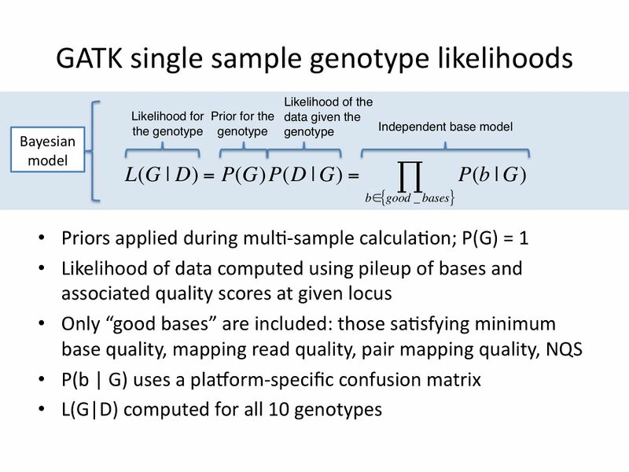

Slide 9
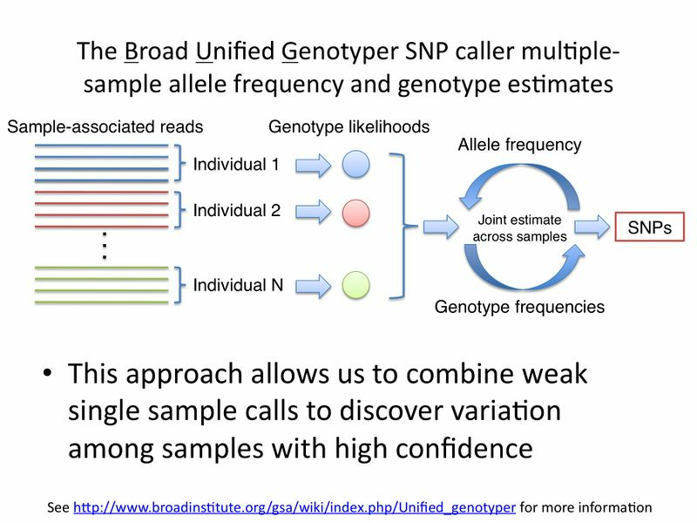

Slide 10
Unified Genotyper
The main program for genotyping SNPs:http://www.broadinstitute.org/gsa/wiki/index.php/Unified_genotyper
Example usage: http://www.broadinstitute.org/gsa/gatkdocs/release/org_broadinstitute_sting_gatk_walkers_genotyper_UnifiedGenotyper.html
Example usage: http://www.broadinstitute.org/gsa/gatkdocs/release/org_broadinstitute_sting_gatk_walkers_genotyper_UnifiedGenotyper.html

Slide 11
Genotype
The UnifiedGenotyper function in GenomeAnalysisTK detects SNPs and genotypes samples:
$ java -jar $GATK_HOME/GenomeAnalysisTK.jar \
-R SINV_subset_1.fa \
-I M350B.accepted_hits.sort.rg.bam \
-T UnifiedGenotyper \
-o M350B.accepted_hits.sort.rg.bam.snps.raw.vcf
(Note: Assumes the BAM file is sorted and indexed)
(Note: Requires read group information and corresponding header lines. See exercise instructions)
This will analyze one sample. The same command can be used for multiple samples.

